Slide 1
Department of Counseling
School Counseling Site Supervisor Training
Notes:
Brenda’s Slide

Slide 2
Department of Counseling Contacts
Associate Professor of Practice
Graduate Advisor of Record
Clinical Mental Health Counseling
Catherine.somody@utsa.edu
Clinical Assistant Professor
Coordinator and Graduate Advisor of Record
School Counseling
Dr. Brenda Jones
Brenda.jones@utsa.edu
Student Development Specialist
Kristina Talamantez
Kristina.Talamantez@utsa.edu
Notes:
Brenda’s Slide

Slide 3
Agenda
Welcome & Introductions
About UTSA’s School Counseling Program
The Role, Requirements, Responsibilities, and Importance of the Site Supervisor
Student Responsibilities
Student scheduling
Questions and Answers
Notes:
Brenda’s Slide
Welcome and thank you for attending our site supervisors training session. We also thank you immensely for agreeing to host a UTSA school counseling internship student during their field experience.
The sharing of your knowledge and expertise is invaluable to our students. You really extend their knowledge base outside the classroom by giving them real-life counseling experiences.
We sent you an electronic copy of the UTSA Clinical Training manual.
Let us know if you have not received a copy.

Slide 4
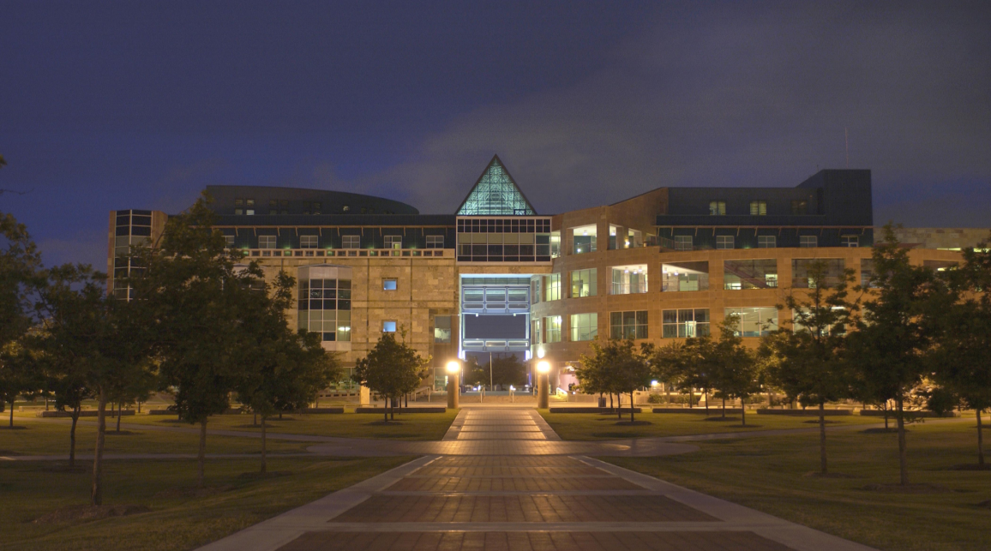
Why pursue a M.Ed. in School Counseling at UTSA?
Evening classes
Downtown campus
Faculty are leaders in the Counseling profession
Prepares students with the skills, identity, and scholarship necessary for a successful school counseling career using The Texas Model for Comprehensive School Counseling Programs (5th ed.) and the Texas Evaluation Model for Professional School Counselors (3rd ed.) textbooks.
UTSA’s counseling program is a CACREP (Council on the Accreditation of Counseling and Related Educational Programs) accredited program.
Prepares multiculturally competent professional school counselors to serve diverse clients in the school setting.
Emphasizes creativity, ethics, and diversity through developmental relationships with students, parents, educators, community members, and other related university programs.
Notes:
Kristina’s Slide: About UTSA’s School Counseling Program
Evening classes– to provide flexibility in student schedules since the majority of them are full-time school teachers during the work day.
Downtown campus- provides easy access to classes, offices, parking and is a smaller, more intimate environment. We offer a variety of class scheduling which includes in person, online, and hybrid.
Faculty are leaders in the counseling profession – many of our faculty serves (or have served as local, state, and national presidents, officers, and committee chairs. Three faculty members are ACA fellows.
Cover the rest of the bullets.

Slide 5
2020-2021 UTSA M.Ed. in School Counseling Stats
How Many Students Graduated?
TExES Passing Rate for School COU Exam
Employment Info
Secured employment within 180 days of graduation
Completion Rate
96%
96%
100%
28
FT & PT SC students completed within 3 years
Notes:
Kristina’s Slide: About UTSA’s School Counseling Program:
We follow up with our school counseling students after graduation using a variety of sources. We are very proud of the statistics that our students produce.

Slide 6
M.Ed. in
School Counseling Program
Program of Study:
60 hours
Includes 100 hours of practicum & 600 hour of internship, totaling 700 clinical hours
Course Title | Hours Awarded
COU 5103-Introduction to School Counseling | 3
COU 5213-Counseling Theories | 3
COU 5223-Clinical Assessment and Appraisal Strategies for Counselors | 3
COU 5233- Group Theory and Process | 3
COU 5243-Diagnosis in Counseling | 3
COU 5253-Child & Adolescent Counseling in a Systemic Context | 3
COU 5283-Counseling Multicultural Settings | 3
COU 5393-Development of Counseling Skills | 3
COU 6003-Consultation and Program Evaluation | 3
COU6153-Career Development and Choice | 3
EDU 5033-Human Development Across the Life Span | 3
EDP 5033-Research Methods in Education | 3
COU 5113 Ethical and Legal Issues in Counseling | 3
COU 5613-Biopsychosocial Aspects of Addiction | 3
COU 6523-Couples and Family Counseling | 3
COU 6883-Trauma, Crisis, & Grief Counseling | 3
COU 5683-Practicum in Counseling (100 hours) | 3
COU 5793-School Counseling Internship I (200 hours) | 3
COU 5803-School Counseling Internship II (200 hours) | 3
COU 5813-School Counseling Internship III (200 hours) | 3
Total | 60
Notes:
Kristina’s Slide:
No Electives
Students’ practicum experience (which lasts one semester) differs from internship in that practicum places a focus on counseling skills only.
Practicum field experiences, unlike internship, do not have to occur on a school campus.
Internship classes (span three semesters) and focus more on implementing the counselors’ roles on a school campus (in addition to the counseling role). Our program focuses on school counseling professional identity, and the implementation of the Texas Model during their class experiences and while at the internship site.
Exceptions in scheduling - Only students who are in the UTSA school counseling program full time are allowed to enroll in internship for two semester (300-hour each semester) rather than over three semesters (200-hours each) semester.
Students in the 300-hour internship must have prior approval from a campus principal (using our form). These students must also commit to 25-30 hours a week at their site in order to complete the required hours by the end of the semester. We want all students to be successful and do not want to support unrealistic expectations. Pursuing the 300 hour route is a nearly impossible task for a part-time student who is teaching full time.
Students are not allowed to see clients or accrue practicum/internship hours between semesters.
Students may continue to see clients during spring break. Students should still be supervised one hour per week on-site during this time.
A second school site may be used to supplement training experiences in the primary school setting for as much as 30% of the internship hours. This would need to be arranged with your instructor on a one-on- one basis. The supervising, state certified school counselor must provide written assurance that the student will be actively involved in 8 of the 11 activities below for a minimum of 14 consecutive weeks in the same school.

Slide 7
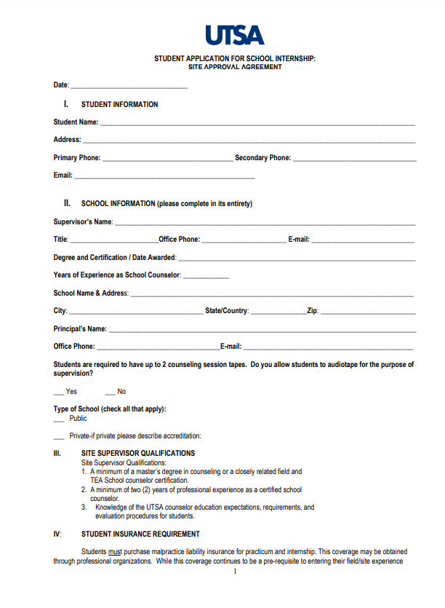
Notes:
Brenda’s Slide:
One way to insure that interns have selected counseling activities that are aligned with student and campus needs, the are required to complete this site approval form with their site supervisors after the have assessed student and campus needs. Students can conduct a smaller needs assessment version or they may use current campus-based results. This is an assignment that is given on the first night of class and is due by the next class meeting. This form must be completed with the site supervisor.
The first page shows the campus demographic information.

Slide 8
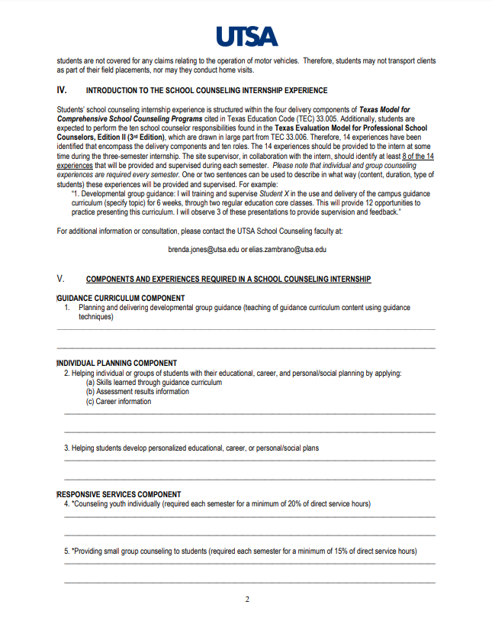
Notes:
Brenda’s Slide:
The next pages of this form highlight the four delivery components. Underneath each component are activities that students may perform. Students must choose, with their site supervisor, 8 of the 14 activities and explain each of the activities in the spaces provided.

Slide 9
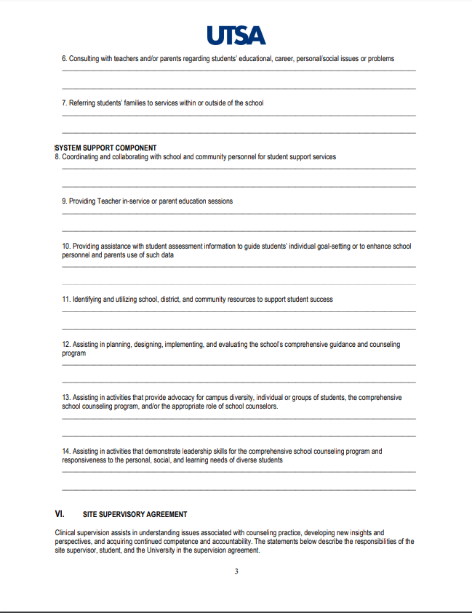
Notes:
Brenda’s Slide

Slide 10
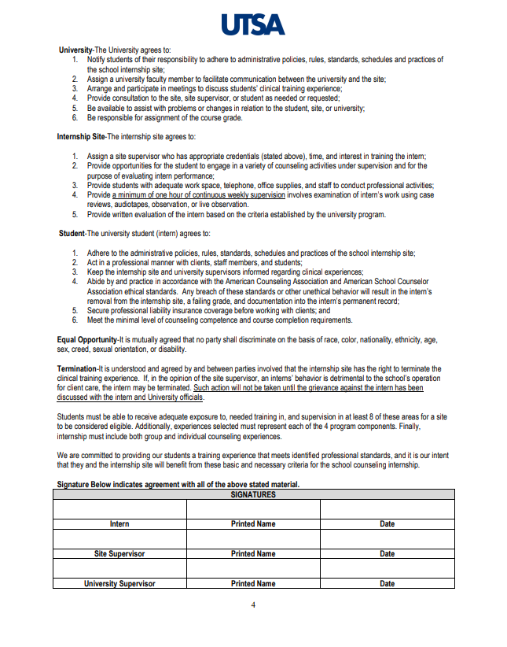
Notes:
Brenda’s Slide:
After the form has been completed, students and site supervisor sign this page to indicate their agreement of activities for this semester.
This form will be completed each semester. It is our hope that students will be introduced to more challenging activities each semester to enhance their knowledge base, skills, confidence, and independence.

Slide 11
Other Requirements
Texas Education Agency (TEA) requires students entering internship I who want to also enter the certification program must participate in an interview process as part of the entry requirements.
TEA requires three 45-minute observations of students during their internship experiences (Classroom Guidance [first semester], Small Group Counseling [second semester], and Consultation [third semester] ).
Notes:
Kristina’s Slide:
At UTSA, starting during internship I, students are asked to compete a written interview regarding knowledge about the Texas Model and will submit answers to interview questions to Dr. Brenda Jones. Once the students’ scores are determined acceptable, the scores are submitted to the certification office to Kimberly Perez.
TEA requires all observations to be at least 45 minutes long. Each observation must include a pre-observation conference prior to the observation, the observation, and a post-observation conference (where the intern is provided standards-based feedback and recommendations about the session.
Site supervisors, interns, the UTSA Certification Office, and Dr. Brenda Jones will receive a copy of the observation feedback immediately after the post-observation session.
We ask that site supervisors assist interns in scheduling this. Sometimes we have students whose work schedules will not allow for an uninterrupted 45 minutes. Some students will collaborate with co-workers to cover classes while the complete their observations. Others will take a personal day to do this. We ask the students to work with their campuses to make this happen.
This is not a pass/fail assignment. Students must adequately demonstrate the necessary skills during the observation. Comments are notated on the observation forms regarding the interns’ strengths observed, appropriateness of activities, responses to student clients’ responses, etc.) that occurred during the observation. During the observation, we assess the students’ levels of competency as they demonstrate skills in classroom guidance, small group counseling and consultation.
Students will have to demonstrate these skills independent of assistance. Site supervisors can observe the students, but cannot assist them during the observation (unless unethical or misinformation occurs).

Slide 12
Texas School Counseling Certification Requirements
Have a Masters in
School Counseling
Teach for 2 years in an accredited school
*teaching experience can be done concurrently with the program
Take and pass the state-required school counseling certification exam
Notes:
Kristina’s Slide

Slide 13
Professional Certification Program
TEA law TAC 19 227.17 (f) states “prior to formal admission, [an EPP] shall not provide coursework, training, and/or examination approval to an applicant that leads to initial certification in any class of certificate.”
All candidates pursuing School Counselor certification must apply and be admitted to the UTSA Teacher Certification Program in order to be approved to enroll and complete the School Counselor internships.
Candidates must make contact with the UTSA Certification Officer to get information on how to apply. Failure to be admitted to the UTSA EPP will result in the candidate being ineligible to complete the School Counselor internships.
Notes:
Kristina’s Slide

Slide 14
The Role of the Supervisor
Supervision is a professional practice; governed by guidelines, professional competence, ethical considerations, and appropriate boundaries.
May serve as a: teacher, mentor, consultant, counselor, sounding board, advisor, administrator, evaluator, recorder/documenter, and coach who empowers
Supervisor Responsibilities are outlined on page 14 of the UTSA Clinical Training Manual.
Notes:
Brenda’s Slide:
The site supervisor cannot hold another certification or license, such as a mental health counselor or social worker.
The site supervisor who is the assigned supervisor cannot be in the second year. They must have completed two full years of school counseling.
200-hour students – direct 80; indirect 120 hours
300-hour students – direct (120 hours and indirect (180 hours).
There are a variety of supervision models (Developmental, Supervisee-centered, Clinical, Administrative, etc.)

Slide 15
Requirements for Site Supervisors
Must be a Texas Education Agency certified school counselor with at least two years experience
Assist interns in planning, organizing, and scheduling direct (80) and indirect hours (120) needed
Facilitate growth and professional functioning of counselor-intern while protecting the welfare of student clients
Provide ongoing objective and honest feedback and formative and summative evaluations
Educate interns on critical issues, as needed.
Inform the university supervisor immediately of concerns with the internship students’ performances.
Notes:
Brenda’s Slide:
300-hour students – 120 direct and 180 indirect clinical hours
Mid-term evaluation and end of semester evaluation – (two forms [one assesses counseling skills and the other assesses standards of the Texas Model], use the same form each time) both developmental
Critical issues – effectively managing student crisis on campus – board policies; Child Protective Services; suicide ideation, pregnancy, LGBT youth, etc.

Slide 16
Importance of Supervision
Effective Supervision:
Is providing one continuous hour of quality supervision on a weekly basis,
Is evaluative,
Is mindful of keeping a developmental approach,
Continues over time,
Continues to monitors the student intern’s and the student clients’ well-being, and
Enhances internship students’ functioning
Notes:
Brenda’s Slide:
Internship students’ skills and confidence continues to develop from semester to semester. We credit the supervisor’s expertise and guidance and opportunities for in-person counseling experiences with school-age children.
Therefore, it is critical that supervisors and interns choose a time for weekly supervision where the least amount of interruptions occur (before and after school or on a Friday afternoon). Quality supervision

Slide 17
Importance of Supervision Continues
Effective Supervisors:
Know their role and functions,
Use a model of supervision,
Are skilled at developing supervisory relationships,
Establish clear boundaries in the supervisory relationship,
Must be aware of and adhere to all ethical and legal guidelines of the profession and school district policies, and
Serve as a gatekeeper of the profession.
Notes:
Brenda’s Slide:
Clinical Supervision, Administrative Supervision – Which model do you use?

Slide 18
Importance of Supervision Continues
Effective Supervisors:
Provides each intern with clinical job description/duties,
Provide client assignment for counseling experiences,
Provides individual and group counseling experiences,
Weekly supervision schedule (i.e., minimum of one hour, face-to-face, individual or triadic),
Provides opportunities for student/trainees’ professional development; and
Participates in a consultation process with UTSA clinical supervisor(s).
Notes:
Brenda’s Slide:
Map out ways to complete clinical hours.

Slide 19
Access to Supervisor
Students must, at all times, have immediate access to their clinical site supervisor, the site supervisor’s representative, or a professional colleague for consultation and support when at their field sites; therefore, students may not work alone at their field sites.
Notes:
Brenda’s Slide:
These are still counselors-in-training - To prevent liability issues

Slide 20
Challenges in Supervision
Culturally Competent Supervision requires:
• Awareness of self
• Awareness of others, and
• Use of culturally specific intervention
Explore multicultural dynamics with intern
• Assist interns in developing cultural self-awareness
• Accept limits as a supervisor
• Model cultural sensitivity
• Educate intern on culturally appropriate interventions
• Practice and promote culturally appropriate intervention
Notes:
Brenda’s Slide:
Changing demographics presents diverse populations for our interns. We must remain mindful of federal, state, and local mandates, along with ethical guidelines when working with interns who, in turn, will be working with school-age students.

Slide 21
Challenges in Supervision Continues
Personal Values
• Guard against imposing your own values, beliefs, and attitudes in supervision • Assist interns to avoid imposing their own values, beliefs and attitudes in supervision and counseling.
• Work on understanding your own values, beliefs, and attitudes and how they impact the supervisory or counseling relationship.
• Help interns understand their own values, beliefs, and attitudes and how they impact the supervisory or counseling relationship.
• Talk openly about values; initiate and invite discussion regarding intern’s values
Notes:
Brenda’s Slide

Slide 22
Students’ Responsibilities
Students are expected to attend all supervision meetings, including group, individual, on-site, and off-site meetings;
Students are expected to develop a schedule with their practicum/internship clinical site supervisors;
Students should immediately notify supervisors and clinical sites in the event of being delayed or absent;
Students should make up any missed supervision or practicum/internship hours;
Students who consistently fail to attend class, supervision meetings, or practicum/internship hours may be dropped from the class or receive a failing grade;
Students who consistently fail to prepare client cases (i.e., with tape recordings) for review may be dropped from the class or receive a failing grade.
While completing practicum and internship experiences, Internship students are not permitted to make any home visits during their practicum/internship experiences unless specifically pre-approved by the Clinical Mental Health Committee.
Notes:
Kristina’s Slide

Slide 23
Students’ Responsibilities Continues
Professionalism
Students should consult with their clinical site supervisor, follow the clinical site dress code, and conduct themselves in a professional manner at all times. Also, students’ professional demeanor should be consistent with the current ethical guidelines of ACA. This is consistent with the requirement of development of a professional identity.
Documentation
Students will complete and submit all required academic and clinical site documentation in a timely and efficient manner. School counselors do not diagnose. Students’ practicum and internship documentation will be used to verify information for the department’s records and reviews, as well as state licensure and/or certification when needed.
Notes:
Kristina’s Slide:

Slide 24
Students’ Responsibilities Continues
Confidentiality
Students will be responsible for maintaining the confidentiality of all information related to their clinical site clients:
Students should understand and follow the legal and ethical confidentiality practices of their clinical site.
Students should maintain their practicum/internship documentation and tape recordings in a secure and professional manner, consistent with the current ethical guidelines of ACA.
Students should not use any client identifying information (e.g., full name, social security number, etc.) in any practicum or internship documentation (e.g., tapes, notes, tape critiques, fax, e-mail, etc.). The exception to this policy/procedure is the client’s consent form(s); and
Students should utilize appropriate coding procedures when documenting any practicum or internship documentation (e.g., tapes, notes, tape critiques, fax, e-mail, etc.).
Students will notify their practicum/internship faculty instructor in the event of a client crisis (actual or potential). Students will notify their practicum/internship faculty instructor, the Clinical Coordinator and the COU Department Chair in the event of a client’s death (e.g., suicide, homicide, etc.).
Notes:
Kristina’s Slide

Slide 25
M.Ed. in School Counseling Sample Schedule
*schedule may not look exactly like this
YEAR I |  |  | YEAR 2 |  |  | YEAR 3
Fall | Spring | Summer | Fall | Spring | Summer | Fall | Spring | Summer
COU 5103 Introduction to School Counseling | COU 5253 Child & Adolescent Counseling | COU 5233 Group Counseling | COU 5683 Practicum | COU 5793 Internship I | COU 5243 Diagnosis | COU 5803 Internship II | COU 5813 Internship III | COU 6153 Career COU
COU 5213 Counseling Theories | COU 5393 Counseling Skills | COU 5283 Multicultural Counseling | EDP 5033 Human Development (Hybrid) | COU 6003 Consultation Skills | COU 5223 Assessment | EDU 5003 Research in Education | COU 6883 Trauma, Crisis & Grief COU | COU 5613 Addictions
 |  | COU 6523 Couples & Family COU |  |  | COU 5113 Ethical & Legal Issues in COU

Slide 26
Licensed Professional Counselor (LPC)
A clinical license that demonstrates that a practitioner possess sufficient knowledge, clinical practice, and supervision to work with clients dealing with mental health issues in private practice and clinical settings.
The LPC is regulated by the Texas Behavioral Health Executive Council.
Students must:
Complete all of the 60-hour course requirements for graduation.
Apply for and take the National Counselor Exam (NCE).
Find an LPC-Supervisor to meet on a weekly basis to supervise the interns as they accumulate the required 3,000 post-graduate clinical hours for licensure.
Seek an board-approved site to complete the required clinical hours
Apply for licensure through the Texas Behavioral Health Executive Council Board.
Notes:
Kristina’s Slide:
This allows counselors to work within their scope of training. I would recommend that students take the Introduction to CMHC.
Clinical hours include 1,500 direct and 1,500 indirect clinical hours.

Slide 27
Internship I School Counseling Assignments
Assignments
Individual counseling tape and tape script: Students’ developing counseling skills will be evaluated through audio and/or visual tapes and tape scripts submitted by the student to the university supervisor.
Counseling Philosophy Paper – this paper consists of derived principles of establishing professional helping relationships with clients who seek assistance in resolving psychological or relational problems. It may include an introduction, your view of human nature, nature of client problems, the process of change and growth, role and responsibility of counselor, your chosen counseling theoretical approach, and ethical and legal responsibilities.
Two evaluation Reports from Site: (1) Fall 2022 Internship Student Performance Evaluation: (Texas Evaluation Model for Professional School Counselors, 3rd Edition) and (2) the UTSA Site Supervisor Evaluation of Counselor-In-Training Form-Counseling only. Site supervisors will evaluate students’ performance using these two instruments to provide feedback regarding development of counselor competencies at mid-term and at the end of the semester.
Brochure project & presentation: Students will create and present a comprehensive school counseling program brochure that can be used as a marketing tool for their program. The brochure will identify appropriate school counselor roles, program deliver components and contact information.
Evaluation of progress from University Supervisor: Students’ cumulative learning will be evaluated by the university supervisor using performance and program data collected from the site, from supervisory sessions, and other assignments.
Program Management Activities: Foundational Components Assignment (Creation of the school counseling mission statements; program definitions for campus-based school counseling program; outlining the rationale and identifying assumptions at the campus level; and establishing campus-based goals) Needs Assessment (in which the student intern collects data on perceived student and campus needs for program planning) and Designing Program Priorities form Semester Activities Calendar Job Description – Internship students define how the roles and responsibilities of the school counselor are aligned with the framework of the comprehensive school counseling program.’
Classroom Guidance Plan (Guidance Plan due at time of scheduled observation)
First formal observation conducted by designated field supervisor of TEMPSC-II guidance domain standards within first six weeks of the internship.
Notes:
Brenda’s Slide:
Developmental

Slide 28
Internship II School Counseling Assignments
Assignments
Individual Counseling Tape and Tape script: Students’ developing counseling skills will be evaluated through audio and/or visual tapes and tape scripts submitted by the student to the university supervisor.
Two evaluation Reports from Site: (1) Fall 2022 Internship Student Performance Evaluation: (Texas Evaluation Model for Professional School Counselors, 3rd Edition) and (2) the UTSA Site Supervisor Evaluation of Counselor-In-Training Form-Counseling only. Site supervisors will evaluate students’ performance using these two instruments to provide feedback regarding development of counselor competencies.
Evaluation of progress from University Supervisor: Students’ cumulative learning will be evaluated by the university supervisor using performance and program data collected from the site, from supervisory sessions, and other assignments.
*Group Counseling Plans submitted for observation
Case Presentations prepared regarding individual counseling session (Outline Provided)
A formal observation (small group counseling) conducted by designated field supervisor of Texas Model guidance, group counseling, and consultation school counselor responsibilities (The Texas Model, Section I)
*Program Management Activities: Foundational Components Assignment Needs Assessment-Program Priorities form Semester Activities Calendar
End-of-Semester Program Implementation & Presentation Student will develop and implement a program based on a needs assessment of their school site. Students will present their project to the class and describe the assessment, implementation, and evaluation process.
Notes:
Brenda’s Slide:
Developmental

Slide 29
Internship III School Counseling Assignments
Assignments
Individual Counseling Tape and Tape script: Students’ developing counseling skills will be evaluated through audio and/or visual tapes and tape scripts submitted by the student to the university supervisor.
Two evaluation Reports from Site: (1) Fall 2022 Internship Student Performance Evaluation: (Texas Evaluation Model for Professional School Counselors, 3rd Edition) and (2) the UTSA Site Supervisor Evaluation of Counselor-In-Training Form-Counseling only. Site supervisors will evaluate students’ performance using these two instruments to provide feedback regarding development of counselor competencies at mid-term and at the end of the semester.
Evaluation of progress from University Supervisor: Students’ cumulative learning will be evaluated by the university supervisor using performance and program data collected from the site, from supervisory sessions, and other assignments.
Consultation Plans submitted for observation
School Counseling Portfolio Requirements: Students will develop a portfolio of personal accomplishments and counseling program related activities. The portfolio should be organized using the TEA delivery components for use in a mock interview. Copies of the following documents are required: leadership and advocacy, community involvement, personal recognition, technology and communication skills, professional membership, professional goals, references, and career planning (resume, cover letter, and wellness plan). The portfolio will be used in a mock interview with local directors of guidance.
A formal observation (Developmental or Remedial Consultation) conducted by designated field supervisor of Texas Model guidance, group counseling, and consultation school counselor responsibilities (The Texas Model, Section I)
*Program Management Activities: Calendar of Activities Revised Professional Development Plan Updated Needs Assessment-Program Priorities forms as needed Leadership and Advocacy Assignment
End-of-Semester Program Evaluation Project: Students will complete and present an evaluation of their campus program that includes program standards used, outcomes assessment of program activities, and intern student’s performance. A power point presentation will be included.
Notes:
Brenda’s Slides

Slide 30
VIDEO FROM SCHOOL COUNSELING STUDENT
https://youtu.be/5IQU1_YnH1Y
Notes:
Kristina’s Slide

Slide 31
Questions and Answers
If you later think of other questions not asked, please feel free to email me:
Brenda.Jones@utsa.edu
Kristina.Talamantez@utsa.edu
Notes:
Brenda’s Slide

Slide 32
Notes:
Brenda’s Slide

