Slide 1
GATE KEEPING, HIPAA (Health Insurance Portability and Accountability Act of 1996, and FERPA (Family Educational Rights and privacy Act)
Gerald Juhnke, Ed.D., LPC, NCC, MAC, ACS
A Very Special Thank You to Dr. Barbara Herlihy for Providing Gate Keeping Materials

Slide 2
IMPORTANT
Given Gate Keeping, HIPPA, FERPA, and State regulations are in a continual state of evolution and change, the basic information contained within this course should be considered rudimentary and evolving.
Regulations are constantly being “re-interpreted” and “re-written”. Therefore, consider these materials to be a starting point for consideration and discussion.
ALWAYS access the current Gate Keeping, HIPPA, FERPA, and State rules and regulations for the most current updates and information.
Annually, participate in Gate Keeping, HIPPA and FERPA updated trainings.

Slide 3
Gate Keeping

Slide 4
Gate Keeping
Gatekeeping is a vitally important function of supervisors.
Gatekeeping often is one of the most uncomfortable functions a supervisor must perform.

Slide 5
Today’s Objectives
1. explore the reasons why gatekeeping is essential to ethical supervision
2. examine consequences (both positive and negative) of gatekeeping interventions
3. discuss effective gatekeeping strategies

Slide 6
Purpose of gatekeeping
Protect clients and the profession from incompetent professional counselors, which is critical to the integrity of our profession.

Slide 7
Gatekeeping:
“Evaluating supervisees to determine whether they should be allowed to progress through their training programs and post-graduate supervision to licensure.” [Remley & Herlihy, 2016]

Slide 8
Remediation
“A documented, procedural process that addresses perceived inabilities in trainees’ performance with the intent to provide trainees with specific means to remedy their deficiencies.” [Dufrene & Henderson, 2009]

Slide 9
History of Gatekeeping
Supreme Court: Horowitz v. Board of Curators of University of Missouri (1978) – established right to dismiss students based on deficits in clinical performance.
Lawsuits: Augusta State and EMU
ACA Code of Ethics, 2014, Standard F.6.b.
CACREP, 2016 Standards

Slide 10
What is the Difference between incompetence and impairment
Differences between incompetence and impairment are often blurry.
Dictionary definitions:
Incompetence:
the quality or condition of being incompetent; lack of ability.
the condition of lacking power to act with effectiveness.

Slide 11
What is the Difference between incompetence and impairment
Differences between incompetence and impairment are often blurry.
Dictionary definitions:
Impairment
the state of being diminished, weakened, or damaged, especially mentally or physically: cognitive impairment in older adults.

Slide 12
What is the Difference between incompetence and impairment
Differences between incompetence and impairment are often blurry.
Dictionary definitions:
Thus, IMPAIRMENT means diminished or weakened or lacking the knowledge or skills to perform at the required level.
In other words, with supervision and training there is an increased probability of being able to function at the required level.
-Conversely, INCOMPETENCE indicates the inability to perform at a required level even if one participates in further training, supervision, and education.

Slide 13
Problems with gatekeeping.
1. Subjective –
no standardized procedures or benchmarks
measuring interpersonal skills and intrapersonal health are much harder to assess than academic performance
no professional standards exist for gatekeeping

Slide 14
Problems with gatekeeping.
3. What to can we assess?
-Dispositions?
-Ethical behavior?
-Professionalism?
-Skills/interventions?
-Receptivity to feedback? ….
4. Gatekeeping is emotionally challenging
-“Blinded by empathy” (Glance et al., 2012)
-As counselors we constantly fight for the underdog!
-We believe all people can change with love, compassion, and supervision

Slide 15
GateKeeping
3. Potential for backlash
Angry supervisee
Lawsuit for discrimination or defamation of character
4. Vicarious liability
Here the clinical supervisor may be liable through association of the supervisee through the supervision relationship.
Supervisee fails to assess client for suicidal ideation and intervention
Supervisee fails to follow supervisor’s directive

Slide 16
Vicarious liability: not as scary as it seems
Very few counselors or counselors-in-training are sued for malpractice.
Malpractice lawsuits against counselors and CITs (and their supervisors) are difficult to win.
Evidence of the low risk:
Average annual cost of malpractice insurance for counselor supervisors: $327 plus supervision endorsement
Average annual cost of malpractice insurance for surgeons who supervise surgery interns: $486,000
(Insurance companies base their rates on exposure to risk)

Slide 17
Strategies for successful gatekeeping:
1. develop a strong supervisory alliance (Truly, it’s all about the relationship!)
2. make expectations clear
3. conduct informal, formative evaluations frequently (no surprises!)

Slide 18
GateKeeping
4. maintain appropriate boundaries (easy to relax boundaries as a supervisee gets closer to being your peer)
5. respect confidentiality rights of supervisee
6. when needed, develop a clear, behavioral remediation plan (no euphemisms)
-no vague directions
-indicate EXACTLY what you expect, what it will look like, and how you want it conducted
-Give directions notes that include carbon copies to review at the next supervision
7. when supervisee is not progressing as needed, get ongoing consultation or supervision for your supervision of this supervisee

Slide 19
GateKeeping
8. make sure your professional liability insurance covers supervision
9. document carefully and thoroughly, contemporaneously (giving notes to the supervisee and maintaining a copy for you at the same time)
10. Keep in mind that gatekeeping creates gateways, which are designed to provide opportunities for supervisees to grow

Slide 20
GATEKEEPING
11. remediation plans do work!
12. take care of yourself!

Slide 21
HIPAA

Slide 22
HIPAA
Health Insurance Portability and Accountability Act of 1996

Slide 23
HIPAA
Purpose
Federal law to create national standards to protect sensitive patient health information from being disclosed without the patient’s consent or knowledge.

Slide 24
HIPaA Four Critical Aspects
Privacy of Healthcare Data
Only authorized individuals are permitted to access patient data

Slide 25
HIPaA Four Critical Aspects
Security of Healthcare Data
Administrative policies and procedures
Physical security measures
Locked offices and cabinets
Locked desk drawers
Computer stations and computers in locked areas when not in use
Technical controls
Encryption
Firewalls
Antivirus software

Slide 26
HIPaA Four Critical Aspects
Notifications of Healthcare Data Breaches
Must notify clients within 60-days of breach
Intent: to protect victims from Fraud or identify theft
Must notify “regulators” of security breach

Slide 27
HIPaA Four Critical Aspects
Client Rights Over Their Healthcare Data
Clients have a right to obtain a copy of their records for minimal or no charge
Copies must be provided within 30-days.
View organizations accounting disclosure log to see what changes or payments have been filed in their treatment

Slide 28
Psychotherapy Notes and HIPaA
IMPORTANT!!
Notes recorded in any medium by a mental health professional documenting or analyzing the contents of conversation during a private counseling session or a group, joint, or family counseling session that are separate from the rest of the individual’s medical record.

Slide 29
Psychotherapy Notes and HIPaA
Psychotherapy notes exclude:
medication prescription and monitoring,
counseling session start and stop times,
the modalities and frequencies of treatment furnished,
results of clinical tests, financial data, and any summary of the following items:
diagnosis,
functional status, the
treatment plan,
symptoms,
prognosis, and progress to date.

Slide 30
HIPPA – Substance Use Disorder
Original regulations were drafted over 30 years ago; substantial revisions were made effective in March 2017
New terminology (e.g., “Substance Use Disorder Patient Records) and attempted relevance in present era of electronic records
Consent (authorization) forms are now somewhat different; they must include an explicit description of the substance use disorder information to be released
Electronic signatures are now permitted
Under HIPAA, records from substance use disorder programs that receive federal funds have specific requirements

Slide 31
What to do if your computer is stolen or hacked?
HITECH identifies four factors to consider in analyzing and deciding whether to notify individuals
1. nature and extent of Private Healthcare Information (PHI),
including types of identifiers and likelihood of re-identification;
2. who the unauthorized person was who used or received the PHI;
3. whether PHI was actually acquired or viewed; and
4. extent to which risk has been mitigated.

Slide 32
Examples of Breaches Potentially Requiring Notice
Laptop, phone or other device with PHI is lost/stolen •
Paper medical records dumped
~ Counselor who “lost” phone in Taxi •
~ Secretary accidentally sends email to all patients with “reply all” activated
• Do you use laptop, cell, etc. with your supervisees?

Slide 33
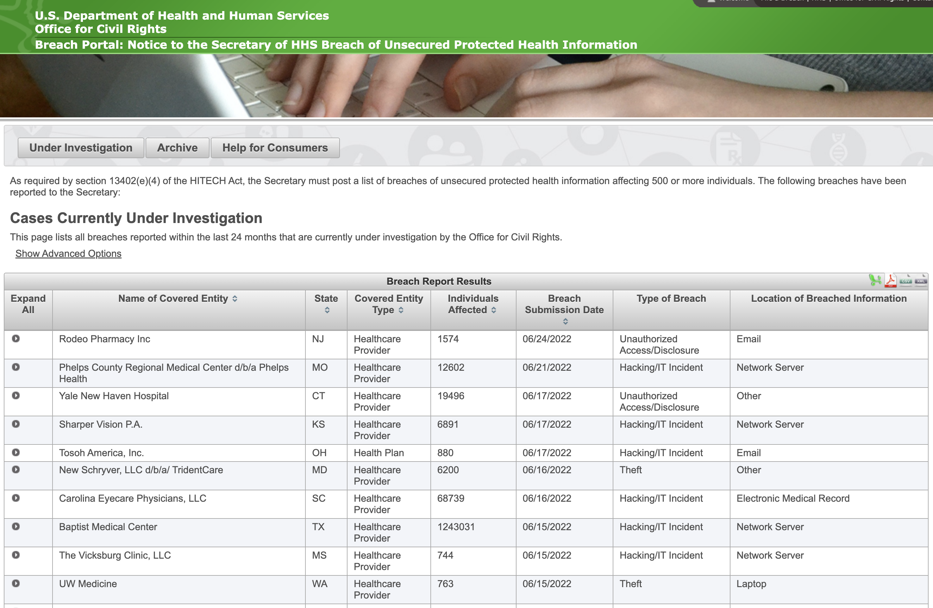
If you must report…
https://ocrportal.hhs.gov/ocr/breach/breach_report.jsf

Slide 34
Continually and Regularly…
Review HIPAA and HITECH regulations to ensure your practice and agency is maintaining confidentiality and security of client personal healthcare information (Quarterly?, Semiannually?, Monthly?)
Remember, software vendors and IT service members likely qualify as business associates and must comply with HIPAA regulations.
Implement security measures sufficient to reduce risks and vulnerabilities to patients/clients.
Create a Sanction policy…apply and document sanctions to workforce members who fail to comply with security policies.

Slide 35
Further…
Ensure all employees, supervisees, supervisors, mental health professionals have appropriate access to electronic Personal Healthcare Information and prevent those who do not from having electronic access.
Create written policies and procedures for authorizing access to electronic Personal Healthcare Information
Key cards
Keys
Passwords

Slide 36
Create Contingency Plans
Data backup
Disaster recovery plan
Implement procedures for periodic testing and revisions of the contingency plans

Slide 37
Removal of Hardware Procedures and Policies
What are your agency’s procedures and policies related to disposal of computers and electric hardware that might contain Personal Healthcare Information
What are your procedures related to storage of Personal Healthcare Information hard drives, flash drives, and flash drive use?
Maintain a record with history of same
Hire an external HIPAA Expert Consultant to review all policies and procedures and create a HIPAA compliant practice or agency.

Slide 38
FERPA

Slide 39
FERPA
Family Educational Rights and Privacy Act
Designed to protect the privacy of students and student records.
FERPA applies to schools accepting funds from the U.S. Department of Education

Slide 40
FERPA Foundational Points
Data must be protected.
Parents and students have rights.
Sharing means, whomever is asking MUST have a need for it and have “legitimate educational interest”
The request must be WRITTEN
Get permission beforehand
“Share with Care” only.
Information is directly related to a specific student.
The shared information will not be “harmful or invasive” if disclosed
Opt out if possible

Slide 41
Differences Between Hipaa and ferpa
HIPAA is designed to keep medical records secure.
FERPA is designed to keep education records private.

Slide 42
How we share information
FERPA was enacted in 1974
Federal law
Determines HOW we share student information.
Designed to Protect Students and Families
Allow parents to view educational records
Dictates which information can be shared

Slide 43
What rights do parents have?
The right to review their child’s educational records.
The right to challenge and seek to amend their child’s education records.
The right to require consent prior to the disclosure of personally identifiable information in educational records

Slide 44
Counselors
Although counselors do not typically maintain student records, counselors need to understand FERPA in regard to:
Confidentiality
Case Notes
Dissemination of Student Information

Slide 45
Educational Records
Are ANY records the school has specific to a student.
Most often these records include:
Grade transcripts
Teacher reports
Work Samples
Notes
Case notes from counselor
Case notes from others (i.e., School Psychologist, Nurse, etc.)

Slide 46
Case Notes
Case notes are of particular concern for counselors
Case notes that are maintained in a school “Student Information System” track attendance, grades, social and emotional well-being, etc. can be accessed by parents at any time
Case notes kept in the sole possession of the counselor, not accessible by anyone else, that are used as a personal memory aid are NOT typically considered educational records.

Slide 47
When is CONSENT NOT REQUIRED
“Directory Information
Name
Grade
Age,
Photo
Sports, band, choir participation
Releasing information to those with legitimate educational interests typically does not require consent
Other teachers within the school seeking to provide additional learning opportunities, etc.
Colleges interested in student
Military

Slide 48
Who are “legitimate Educational Interests”
Colleges
Military
Teachers and counselors talking PRIVATELY in office with door shut (no hallway chatter).

Slide 49
Student Is making threats on facebook
FERPA permits the sharing of information during health and safety emergencies to keep students, staff, and community safe.

Slide 50
Before Sharing ASK Yourself…
Who am I sharing with?
What documentation do they have to support they are who they say they are and photocopy that information and consult with principal.
What am I sharing?
Why does this person need/want this information?
Where am I going to share this information (never in hallway, never in public)
How am I sharing this information

Slide 51
Consequence of Breaching Confidentiality
Loss of federal funds
Potential criminal and civil liability
Loss of license
Potential harm to student

Slide 52
Minimally Share
Be “conservative” with your sharing
Stick to the facts
Do not “free style”

Slide 53
Can you Share Information IF?
You’ve been meeting with a student on a weekly basis regarding his ongoing home “concerns” about mom and dad arguing at home. Now the parents are divorcing, and mom wants your case notes for her custody case.
Must you provide your notes?
Typically, you must share notes if your notes are on a computer system other counselors and administrators can view.
If your notes are ”private” and only from you, and only on a computer or in a notebook only you have access, you typically are NOT required to share.

Slide 54
Do you have to share your notes If…
Child Protective Services comes to your school and asks to see the records of a student, but your principal says you cannot share the records unless the CPS worker provides a court order.
Typically, CPS workers have legal access to your records. And, your principal is incorrect.

Slide 55
What about?
Previously absent fathers or mothers who now show up at your school with legal guardianship or co-guardianship and want to see their child’s grades.
Typically, UNLESS there is a court order stating the previously absent parent has no rights, the parent has the right to access the student’s records.
Of course you likely will want to speak to the student and other parent to let them know the previously absent parent sought this information and was provided this information.

Slide 56
Physical controls
Keep information locked and secured
Locking drawers, cabinets
Clear workspace

Slide 57
Technical Controls
Secure systems and devices
Authentication software
Strong passwords

Slide 58
FERPA and HIPPA Compliant
Is about PEOPLE!
Keep their information safe.
Share only with CARE!
Share only what you would want shared and protect your student’s privacy.
Always VERIFY!
Act as though your e-mails are public documents.
Do not store or open sensitive information on personal devices.
Always log out and lock it down!

