Slide 1
Site Supervisor Training:
Practicum and Internship Requirements and Course Expectations
By Dr. Catherine Somody

Slide 2
Practicum and Internship Requirements
1

Slide 3

Supervisor Requirements for Field Placement
Licensed Mental Health Practitioner with a minimum of a Master’s degree and at least 2 years post-graduate experience
  LPC
  LPC Associate
  LCSW
  Licensed Psychologist
  Psychiatrist or MD
  Psychiatric Nurse Practitioner (NPP)

Slide 4

Site Supervisor Responsibilities
Provide average of one hour per week of Individual or Triadic (2 students) SUPERVISION,
Group supervision is optional and does not replace individual/triadic supervision
Provide opportunity for DIRECT hours: face-to-face interactions with clients.
Provide an opportunity to work with clients over time so they can create a treatment plan and develop case-conceptualization skills.
Provide opportunity for INDIRECT hours: supervision, record keeping, professional development, research, consultation, etc. These hours may be performed outside of the internship site.
Intern tasks must be related to counseling activities

Slide 5
Site Supervision
Students must, at all times, have immediate access to their clinical site supervisor, the site supervisor’s representative, or a professional colleague for consultation and support when at their field sites; therefore, students may not work alone at their field sites or make home visits.
Supervisors complete a midterm and final evaluation of the student using the form provided by the student.
Additional information on supervision is included in a separate site supervisor training available on our website.
Please contact the student’s instructor if you have any concerns about the student’s performance or internship requirements.

Slide 6
Hour Requirments
Minimum direct hours requirements: Practicum = 40 direct out of 100; Internship = 120 direct out of 300.
Practicum students must have a minimum of 10 hours of group counseling experience.
Internship students are encouraged but not required to have group hours. Group hours must be limited to half of their total direct hours. (20 hours for practicum, 60 hours for internship.)
Please limit shadowing or observation. A limited number of hours may be counted for shadowing during training, but not throughout the semester.
Co-facilitation is allowed, especially for groups or families, but students also need experience with counseling clients on their own.

Slide 7
Intern Responsibilities
Attend all supervision meetings unless prior arrangements are made,
Develop a schedule with their clinical site supervisor,
Immediately notify supervisors and clinical sites in the event of being delayed or absent,
Make up any missed supervision or practicum/internship hours,
Communicate effectively with site and university supervisors
Follow all site expectations regarding professional behavior and dress.
Understand and follow the legal and ethical confidentiality practices of their clinical site.

Slide 8
Crisis Procedures
Students must know, understand, and be able to implement the appropriate crisis procedures (e.g. suicide, violent behavior, aggression, etc.) at their clinical site.
Students will notify their clinical site supervisors immediately of any client (i.e., actual or potential) crisis situation, and will follow the site supervisor’s explicit directives.
Students will notify their practicum/internship faculty instructor in the event of a client crisis (actual or potential).

Slide 9
Instructor Responsibilities
Provide group supervision an average of 1.5 hours per week,
Consult with students regarding cases or other concerns,
Consult with site supervisor as needed,
Review site supervisor evaluations,
Review student work and assign final grade

Slide 10
Course Expectations
2

Slide 11
Practicum and Internship Courses
Students in practicum are building their basic counseling skills and developing their theoretical orientation.
Students in Internship are developing more advanced counseling skills and continuing to develop their theoretical orientation.
All students are required to complete two tapescripts with analysis.
All students are required to develop a treatment plan and present a case-conceptualization to their class.

Slide 12
Clinical Log
Students must keep a detailed record of their hours and the work they do.
Each week, the student transfers the number of hours to their clinical log.
Supervisors, please initial the log each week so that you can monitor their hours.
Direct and Indirect Hours: All direct hours must be face-to-face with clients. Round up to the nearest hour or half-hour. (e.g., 50 minutes is considered one clinical hour. 30 minutes is considered .5 clinical hours.)
    Individuals, couples, and families are counted as individual direct hours.
    Group hours are counted as group direct hours.
    Class time is counted as Group supervision.
    Individual or Triadic Site supervision is counted as Individual Supervision.
    Group site supervision (if provided) is counted as Group Supervision.
    All other work such as research, consultation, training, progress notes, etc., is counted as Administrative Hours.

Slide 13
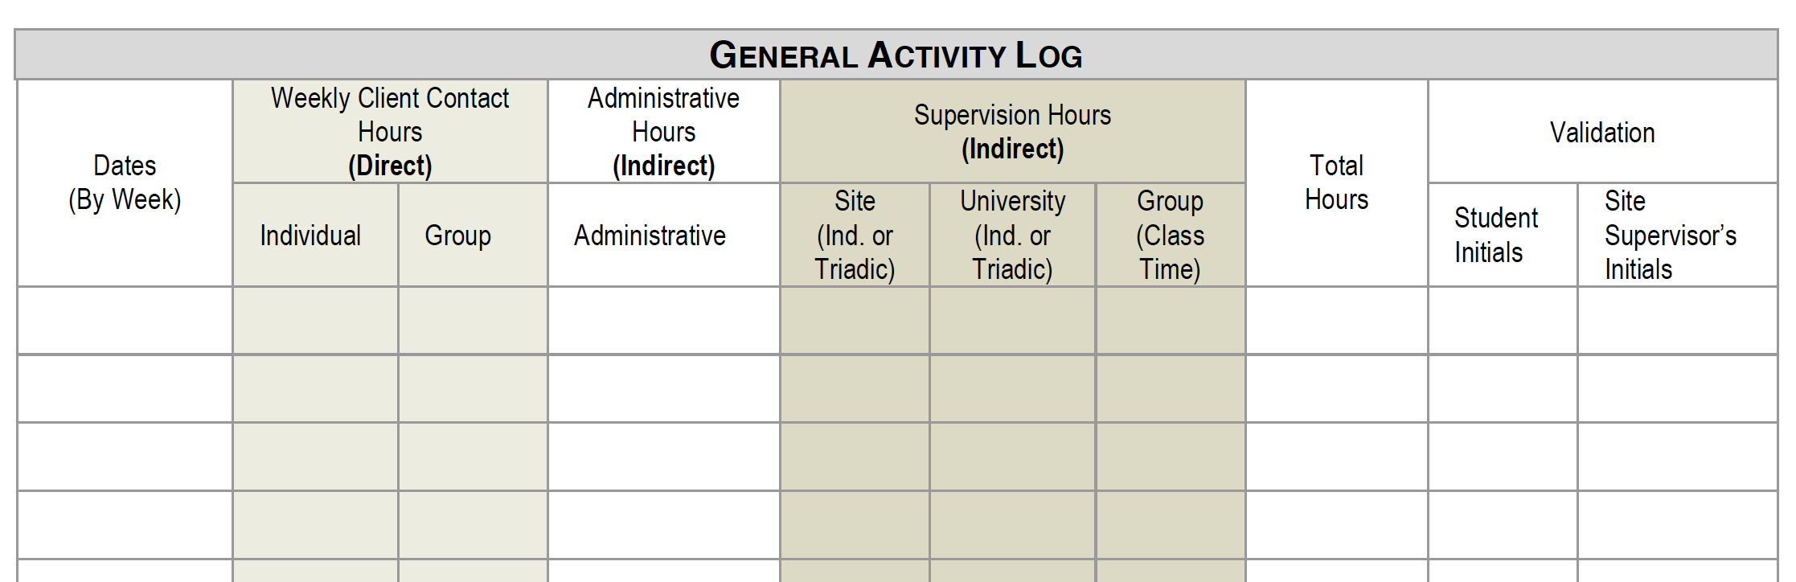
Clinical Log Sample

Slide 14
Transcript Requirements
Students must secure consent for recording from client. This can be our form or it can be a form you provide at the site. Some sites include this on their consent for counseling.
Student must record a full session. (audio or video)
Tapescripts should be 20 consecutive minutes of counselor-client interaction.
Student do not use any identifying information on the tapescript and all recordings are deleted after the assignment is graded.

Slide 15
Tapescript Sample
Client Pseudonym, age, sex, date of session, session number, theoretical model, and techniques employed.
Counseling Response | Skill Demonstrated (a) and Theoretical Intent (b) | Critique (c) and Alternative Response (d)
Tell me more about your reasons for coming in today | (a) Open question. (b) encourage client to elaborate on the problem. | (c) I think this skill was effective in helping the client open up more about their concerns. (d) “You seem both anxious & relieved about coming in today” Reflection of Feelings
Client: Since grandpa’s funeral, I can’t seem to stop crying. I knew he was going to die, but I didn’t expect it to hit me this hard.
You feel hurt. | Reflection of Feeling. -show that I am listening and connecting with the client and validate feelings. | I think a reflection of feeling was appropriate, but I could have used more descriptive feeling words and included a reflection of meaning “You tried to prepare yourself, but you are now feeling overwhelmed with sadness and grief because your grandfather was such an important part of your life.” Reflection of meaning

Slide 16
Tapescript Reflection Paper
Additional Questions:
What did you do well in this session?
What do you wish you had done differently?
What are some reoccurring difficulties or patterns you are experiencing?
What specific parts of the tape/session would you like help on?
How did this session affect you? (e.g., your own personal issues or feelings came into the session)
Brainstorm avenues for further counseling with this client.
Additional comments:

Slide 17
Case Presentation
Make one formal case presentations to the class. In addition to the oral presentation, submit a written case presentation and a copy of the clients’ treatment plan.
Identifying Data
Relevant Background Data and Current Status
Your Conceptualization of the Case (Provide a copy of your treatment plan)
Goal(s)/Target(s) for Client Change
Counseling Process (Briefly describe your approach to working with this client)
Solicit Feedback
What particular difficulties are you having with this case?
What kind of help/feedback would you like from this group?

Slide 18
Treatment Plan
Students may use a treatment plan format from their site, or this template with 1 – 2 problems identified:
Treatment Plan
Problem 1:
Provisional Diagnosis
Goal:
Objective 1:
Objective 2:
Interventions:

Slide 19
For More Information
Please see the Clinical Training Manual for Students, Supervisors, and Site Supervisors (pdf)
Feel free to email the clinical experience committee or your intern’s class instructor for more information.
Clinical Experience Committee
Dr. Gerald Juhnke, Chair: Gerald.juhnke@utsa.edu
Dr. John Harrichand: john.harrichand@utsa.edu
Dr. Claudia Interniano-Shiverdecker: claudia.interiano-shiverdecker@utsa.edu
Dr. Catherine Somody: catherine.somody@utsa.edu

