Slide 1
Student Orientation
Practicum in Counseling and
CMHC Internship
By Dr. Catherine Somody

Slide 2
Practicum and Internship Expectations and Requirements
1

Slide 3
Welcome to Practicum or Internship
Congratulations on reaching this milestone.
Your first experience seeing real clients will be a defining moment in your career.
Remember, you are very well-trained and you have so much to offer!

Slide 4
Hour Requirements
Minimum direct hours requirements for Practicum = 40 direct out of 100 total.
Practicum students must have a minimum of 10 hours of group counseling experience.
Minimum direct hours requirements for Internship = 120 direct out of 300 total.
Direct hours are face-to-face (in person or virtual) with clients.

Slide 5
Hour Requirements (cont’d)
Individuals, couples, and families count as individual direct hours.
Examples of indirect hours: administrative tasks, researching to meet client needs, documentation, phone calls, case consultations, time spent on tapescripts, etc.
Co-facilitation is allowed, especially for groups or families, but students also need experience with counseling clients on their own.
Clinical log is your responsibility and must be initialed each week by your supervisor. More on that later.

Slide 6
Site Supervision
Your supervisor is there to help. Please stay in close contact with your supervisor and share your syllabus and professor contact info.
You must receive an average of one hour per week of Individual or Triadic (2 students) SUPERVISION,
Group supervision is optional and does not replace individual/triadic supervision
You must, at all times, have immediate access to your clinical site supervisor, the site supervisor’s representative, or a professional colleague for consultation and support when at their field sites; therefore, students may not work alone at their field sites or make home visits.
Your supervisors will complete a midterm and final evaluation for your professors. Please be sure and ask for this with plenty of time for completion before the deadline.

Slide 7
Practicum and Internship Student Responsibilities
Attend all supervision meetings and client appointments unless prior arrangements are made,
Develop a schedule with your clinical site supervisor,
Immediately notify supervisors and clinical sites in the event of being delayed or absent,
Make up any missed supervision or practicum/internship hours,
Communicate effectively with your site and university supervisors.
Follow all site expectations regarding professional behavior and dress.
Understand and follow the legal and ethical confidentiality practices of your clinical site.

Slide 8
Crisis Procedures
Students must know, understand, and be able to implement the appropriate crisis procedures (e.g. suicide, violent behavior, aggression, etc.) at their clinical site.
Students will notify their clinical site supervisors immediately of any client (i.e., actual or potential) crisis situation, and will follow the site supervisor’s explicit directives.
Students will next notify their practicum/internship faculty instructor in the event of a client crisis (actual or potential).
For any client concerns, contact your site supervisor first, then you university supervisor if needed.

Slide 9
Instructor Responsibilities
Provide group supervision an average of 1.5 hours per week,
Consult with students regarding cases or other concerns,
Consult with site supervisor as needed,
Review site supervisor evaluations,
Review student work and assign final grade.

Slide 10
Course Expectations and Clinical Forms
2

Slide 11
Practicum and Internship Courses
Students in practicum are building their basic counseling skills and developing their theoretical orientation.
Students in Internship are developing more advanced counseling skills and continuing to develop their theoretical orientation.
All students are required to complete two tapescripts with analysis.
All students are required to develop a treatment plan and present a case-conceptualization to their class.
Refer to your class syllabus for due dates and other specific class requirements.

Slide 12
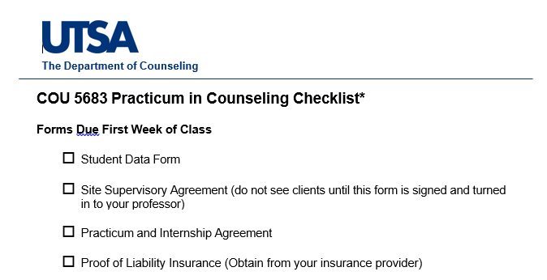
Forms for Practicum and Internship
All forms are located on the department of counseling website.
https://education.utsa.edu/departments/counseling/
The forms checklist and your syllabus will guide you regarding forms and dues dates.

Slide 13
Clinical Log
You must keep a detailed record of your hours and the work you do.
Each week, you will transfer the number of hours to your clinical log.
Your supervisor must initial each week.

Slide 14
Clinical Log Sample

Slide 15
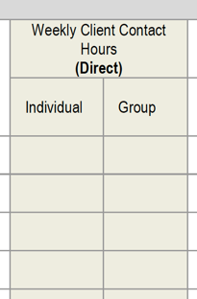
Direct Hours
All direct hours must be face-to-face with clients. Round up to the nearest hour or half-hour. (e.g., 50 minutes is considered one clinical hour. 30 minutes is considered .5 clinical hours.)
Individuals, couples, and families are counted as individual direct hours.
Group hours are counted as group direct hours.

Slide 16
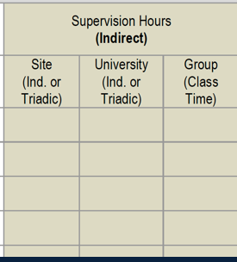
Supervision Hours (Indirect)
Class time is counted as ‘Group class time supervision.’
Individual or Triadic Site supervision at your site is counted as ‘Site Individual Supervision.’
Group site supervision (if provided) is counted as ‘Group Supervision.’

Slide 17
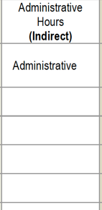
Administrative Hours (Indirect)
Class time is counted as Group supervision.
Individual or Triadic Site supervision at your site is counted as Individual Supervision.
Group site supervision (if provided) is counted as Group Supervision.
All other work such as research, consultation, training, progress notes, time spent on tapescripts and class assignments, etc., is counted as Administrative Hours.

Slide 18
Transcript Requirements
Students must secure consent for recording from client. This can be our form or it can be a form you provide at the site. Some sites include this on their consent for counseling.
Student must record a full session. (audio or video)
Tapescripts should be 20 consecutive minutes of counselor-client interaction.
Student do not use any identifying information on the tapescript and all recordings are deleted after the assignment is graded.

Slide 19
Tapescript Sample
Client Pseudonym, age, sex, date of session, session number, theoretical model, and techniques employed.
Counseling Response | Skill Demonstrated (a) and Theoretical Intent (b) | Critique (c) and Alternative Response (d)
Tell me more about your reasons for coming in today | (a) Open question. (b) encourage client to elaborate on the problem. | (c) I think this skill was effective in helping the client open up more about their concerns. (d) “You seem both anxious & relieved about coming in today” Reflection of Feelings
Client: Since grandpa’s funeral, I can’t seem to stop crying. I knew he was going to die, but I didn’t expect it to hit me this hard.
You feel hurt. | Reflection of Feeling. -show that I am listening and connecting with the client and validate feelings. | I think a reflection of feeling was appropriate, but I could have used more descriptive feeling words and included a reflection of meaning “You tried to prepare yourself, but you are now feeling overwhelmed with sadness and grief because your grandfather was such an important part of your life.” Reflection of meaning

Slide 20
Tapescript Reflection Paper
Additional Questions:
What did you do well in this session?
What do you wish you had done differently?
What are some reoccurring difficulties or patterns you are experiencing?
What specific parts of the tape/session would you like help on?
How did this session affect you? (e.g., your own personal issues or feelings came into the session)
Brainstorm avenues for further counseling with this client.
Additional comments:

Slide 21
Case Presentation
Make one formal case presentations to the class and submit a copy of the client’s treatment plan to your professor. Internship students also submit a written case presentation.
Identifying Data
Relevant Background Data and Current Status
Your Conceptualization of the Case (Provide a copy of your treatment plan)
Goal(s)/Target(s) for Client Change
Counseling Process (Briefly describe your approach to working with this client)
Solicit Feedback
What particular difficulties are you having with this case?
What kind of help/feedback would you like from this group?

Slide 22
Treatment Plan
Students may use a treatment plan format from their site, or this template with 1 – 2 problems identified:
Treatment Plan
Problem 1:
Provisional Diagnosis
Goal:
Objective 1:
Objective 2:
Interventions:

Slide 23
REMEMBER- You Are Well Prepared!
It is normal to be nervous about seeing clients!
Your job is to be a good listener and use your basic skills to establish rapport.
Listen with unconditional positive regard, non-judgemental compassion and empathy.
Reflect content, feelings and meaning and you are on your way to establishing a strong therapeutic relationship and helping your client.
TRUST THE PROCESS!

Slide 24
Frequently Asked Questions
When is the last day to complete my hours?
What if can’t complete my hours?
What if my site does not offer groups?
What if my client does not want to be recorded?
Am I allowed to co-counsel individual sessions?
Who signs my LPC form?
For More Information, please see the Clinical Training Manual for Students, Supervisors, and Site Supervisors (pdf)

