Slide 1

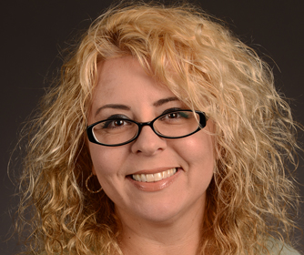
Welcome to the COEHD!
http://education.utsa.edu
Dr. Margo DelliCarpini

Slide 2
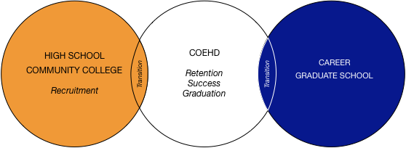
Student Success Center
OUR MISSION
To facilitate undergraduate students’ successful academic transition from entry into the University to graduation.
To support and mentor students in how to best meet their identified career goals.
To identify opportunities for undergraduate students to further develop their engagement and leadership academic experiences.

Slide 3
COEHD Undergraduate Departments/Programs
Interdisciplinary Teaching and Learning
Bicultural Bilingual Studies
Race, Gender, Ethnicity, and Sexuality Studies

Slide 4
Department of Interdisciplinary Learning and Teaching
MB 2.212
(210) 458-5969

Slide 5
Bachelor of Arts Degree in Interdisciplinary Studies with Certification
EC-6
Generalist
Bilingual
English as a Second Language
Middle School
Generalist
Bilingual
English as a Second Language
All Level
Special Education
Math and Science
Language , Arts, Reading and Social Studies

Slide 6
Secondary Certification (grades 7–12)
Content:
Pedagogy:
Bachelor’s degree in the academic discipline
Department of Interdisciplinary Learning and Teaching
Secondary Certification

Slide 7
Undergraduate Degree Programs without Certification
Bachelor of Arts in Interdisciplinary Studies (degree-only concentration)
Bachelor of Arts in Multicultural Early Childhood Development

Slide 8
BA in Multicultural Early Childhood Development
Focus
Quality early learning experiences
Collaboration with families
Programs for dual language learners
Early Intervention principles and practices
Leadership and advocacy in early childhood

Slide 9
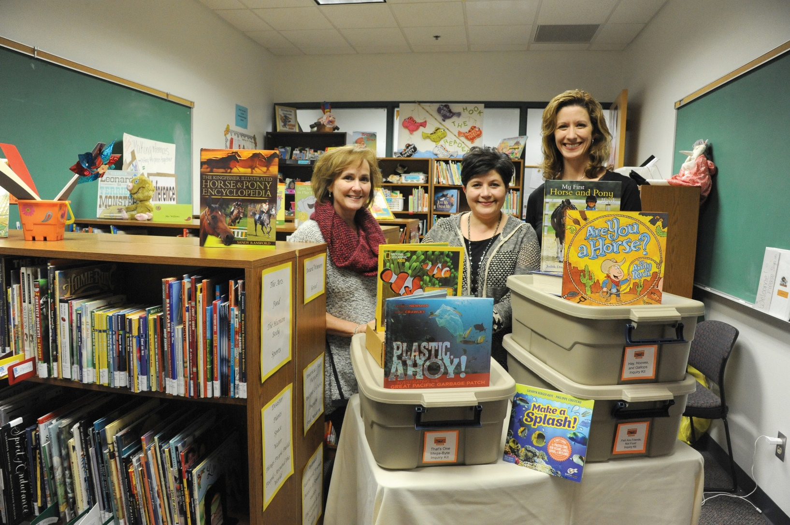
La Plaza de Lectura

Slide 10

The San Antonio Writing Project (SAWP)
Summer Institute, in-service faculty development for local teachers including Super Saturdays series and Open Institutes,
Annual SAWP Teachers Conference,
Summer Young Writer’s Camps for area youth,
the Cuentos Project and the Writing Marathon.

Slide 11
Department of Bicultural-Bilingual Studies
MB 3.112
(210) 458-5570

Slide 12
Bicultural Bilingual Studies
Certification in Bilingual Education
(with B.A.-IDS) Grades EC-6 and 4-8
Certification in English as a Second Language (with B.A.-IDS) Grades EC-6 and 4-8

Slide 13
Bicultural Bilingual Studies
Minors available in
  Bicultural Studies
  English as a Second Language

Slide 14
Department of Race, Gender, Ethnicity, and Sexuality Studies

Slide 15
Race, Gender, Ethnicity, and Sexuality Studies
Bachelor of Arts in Women’s Studies
Bachelor of Arts in Mexican American Studies
Minor in African American Studies
Minor in Women’s Studies

Slide 16
Bachelor of Arts in Mexican American Studies
The Bachelor of Arts in Mexican American Studies program prepares students to enter graduate school or pursue a career as an educator, researcher, community leader or community advocate.
Bachelor of Arts in Women’s Studies
The Bachelor of Arts in Women's Studies program provides students with the opportunity to examine the social, historical, political, and cultural experiences of women and men from an interdisciplinary perspective.

Slide 17
Minor in African American Studies
The Minor in African American Studies program provides an interdisciplinary approach to the political, cultural, historical, and social experiences of African Americans in the United States, and people of African descent globally.
Provides an interdisciplinary approach to the political, cultural, historical, and social experiences of African Americans in the United States.

Slide 18
Women’s Studies Institute and Program
Bachelor of Arts in Women’s Studies
Minor in Women’s Studies
The Minor in Women's Studies program provides students with the opportunity to examine the social, historical, political, and cultural experiences of women and men from an interdisciplinary perspective.

Slide 19
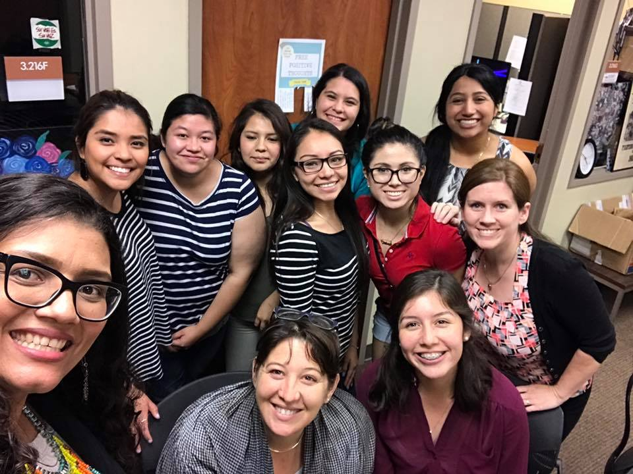
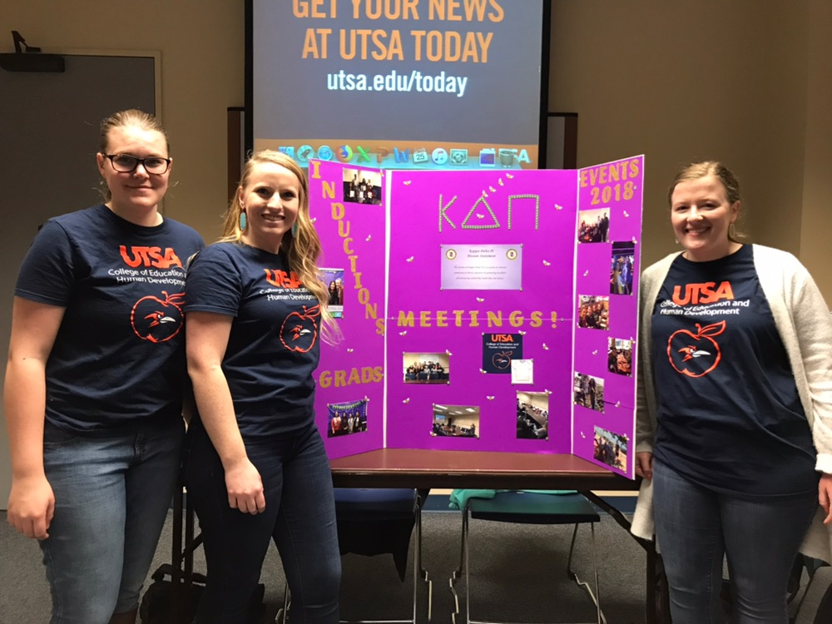
Student Organizations
Bilingual Educator Student Organization (BESO)
Kappa Delta Pi (KDP)

Slide 20
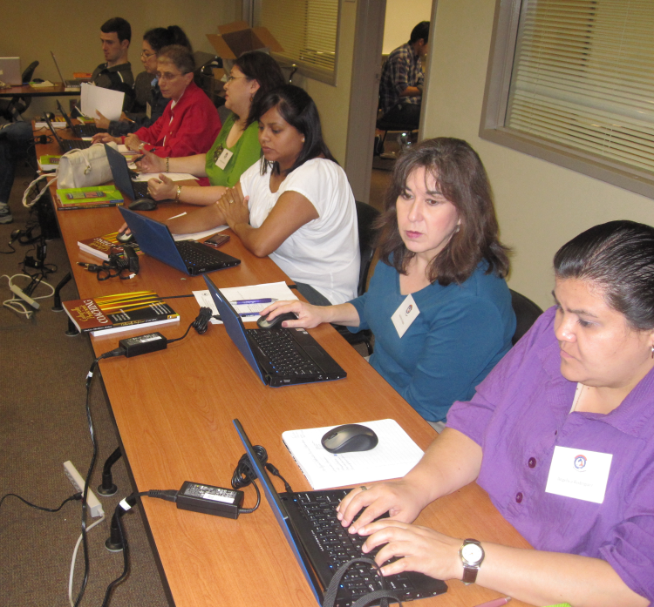
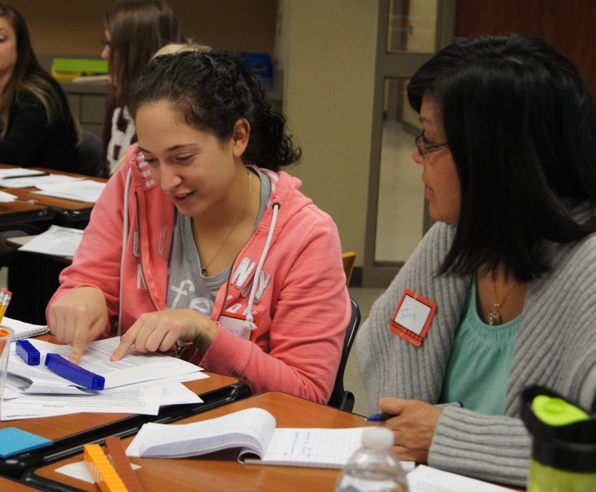
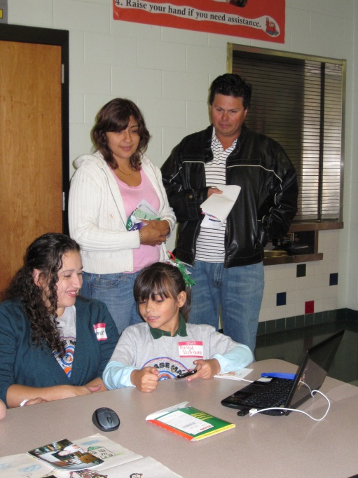
Academy for Teacher Excellence Research Center
Teacher Academy Learning Community (TALC)
Student support division of the Academy for Teacher Excellence Research Center committed to supporting high school and undergraduate and graduate students as they face the academic, emotional, and psychosocial challenges that may occur while completing a college education.

Slide 21
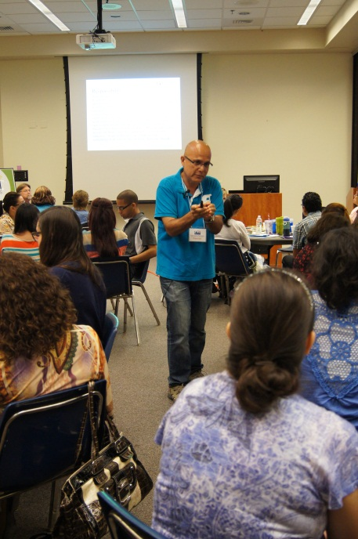
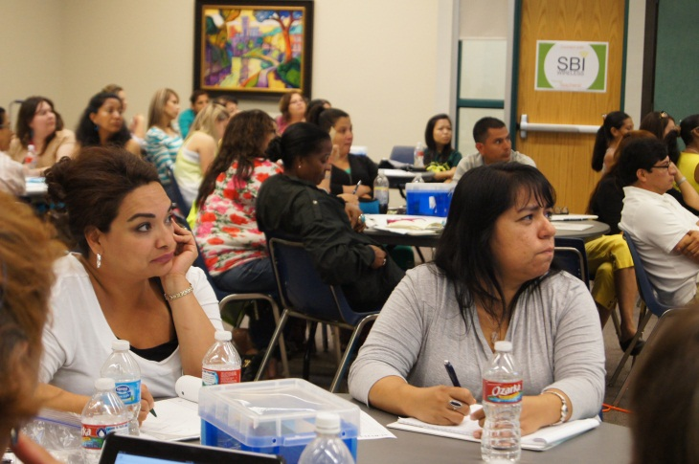
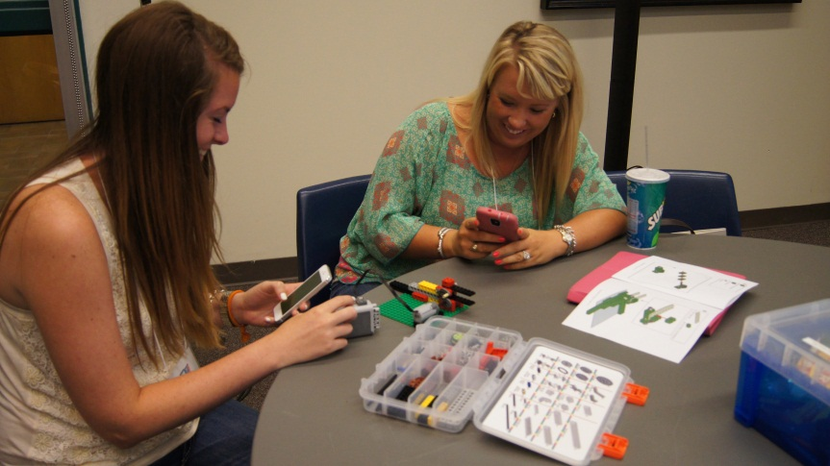
Benefits of TALC
  Textbook lending
  Access to resources and networking opportunities on the eCommunity of Practice
  Free workshops and trainings
  Service learning opportunities through informal learning clubs
  Mentoring from graduate students and alumni
  College Career Transition Guidance

Slide 22
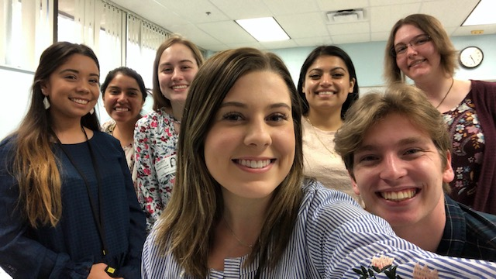
A day in the UTSA-NISD Residency life
Teacher Residency Model 2.0
Notes:
MD

Slide 23
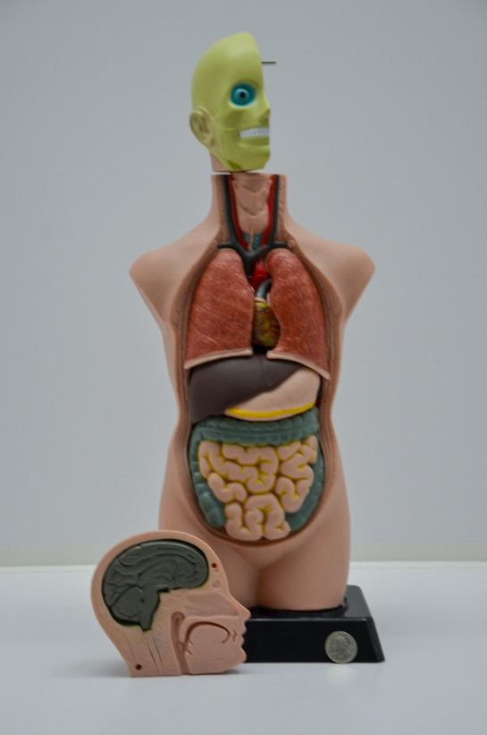
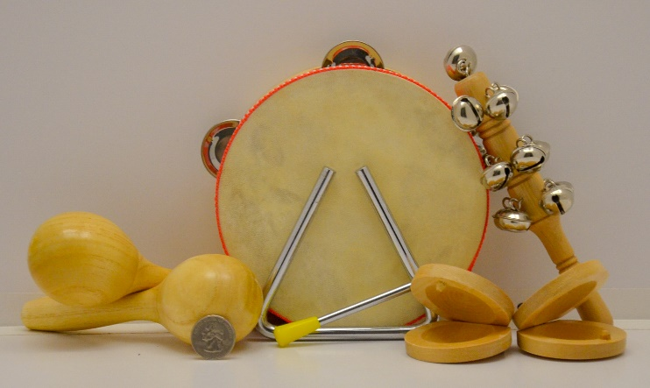
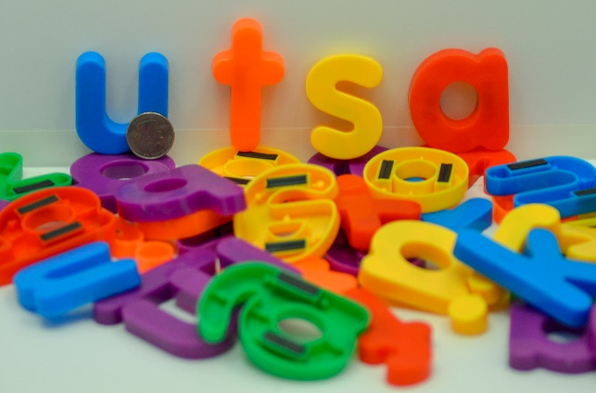

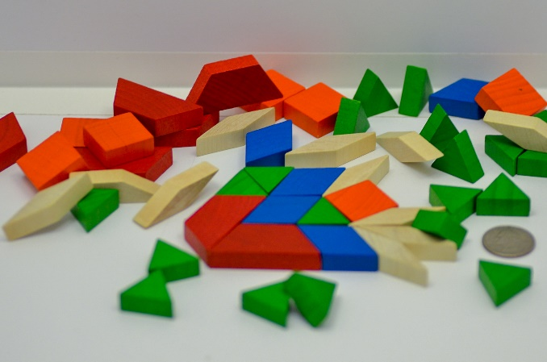
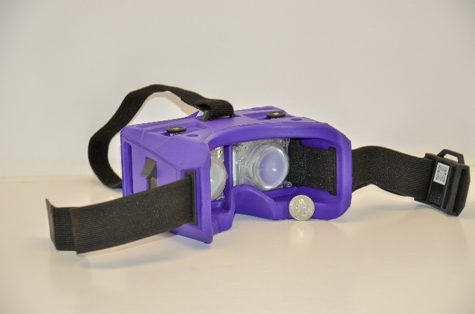
Curriculum Collection at UTSA Libraries
Students can explore and check out curriculum and instructional resources needed for field experiences and clinical teaching.

Slide 24
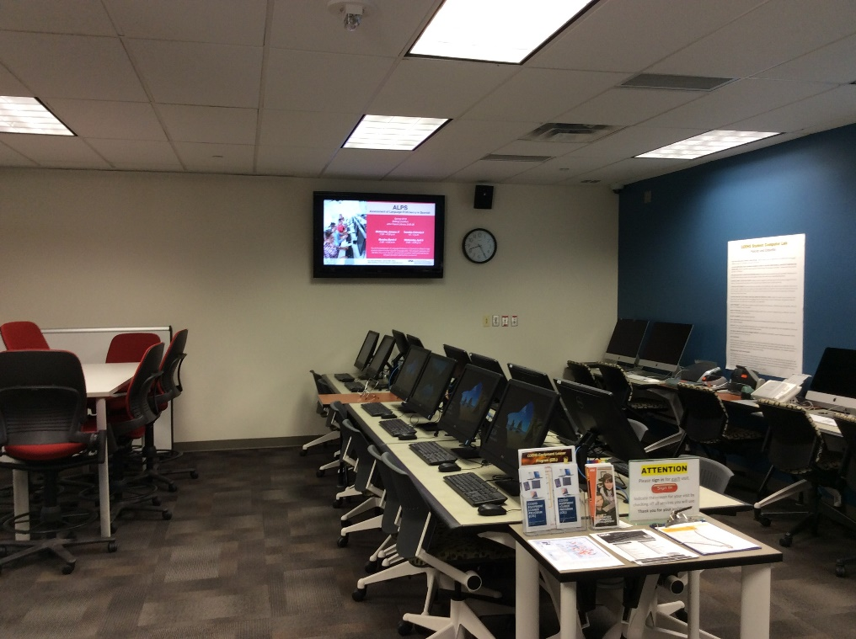
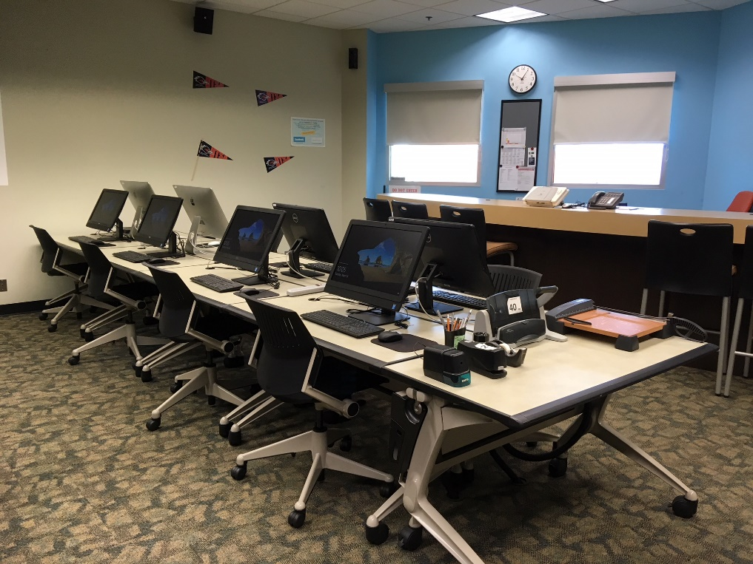
COEHD Student Computer Labs
Computer labs are available at the Main and Downtown campuses.
Equipment Loaner Program
Poster printing and laminating provided

Slide 25
Creating your Student Success
Story

Slide 26
Student Advocacy Board
Established student group that works with the College to assist with recruitment and retention initiatives
Assists in facilitating student needs
  Transitioning support
  Curricular assistance
  Consultative collaboration

Slide 27
Questions
Please direct questions to:
Dr. Norma Guerra
Associate Dean for Undergraduate Studies
Norma.Guerra@utsa.edu
(210) 458 - 4416

